Slide 1
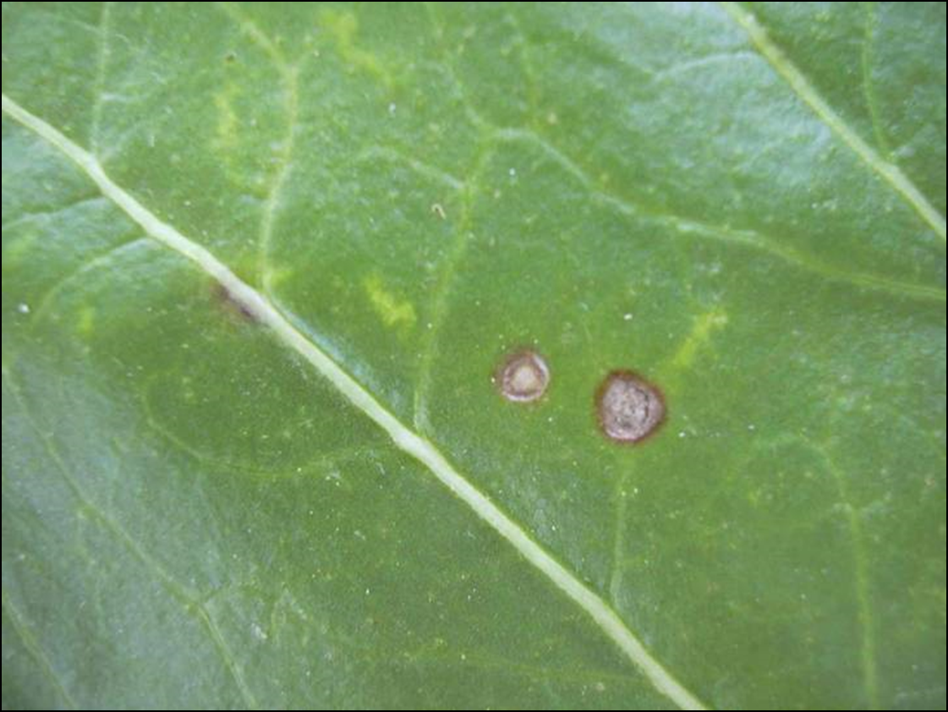
Sugar Beet Breeding Progress Update of Cercospora Tolerant Varieties in North America
ASSBT Conference, February 27, 2019
JAY MILLER Director of Product Management
PATRICK O’BOYLE Plant Breeder
MARGARET REKOSKE Director of Breeding and Product Development

Slide 2
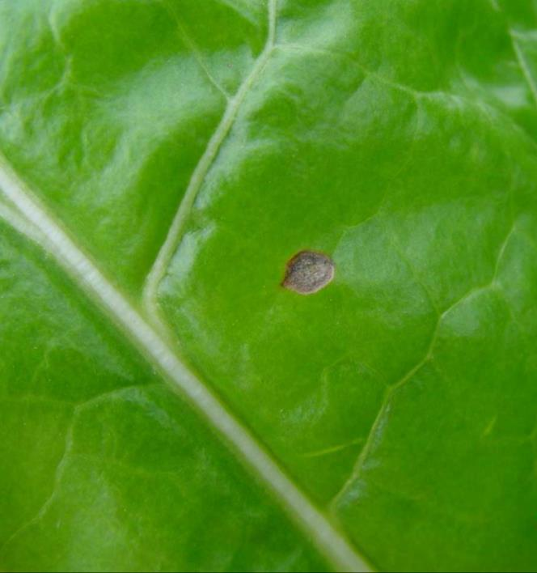
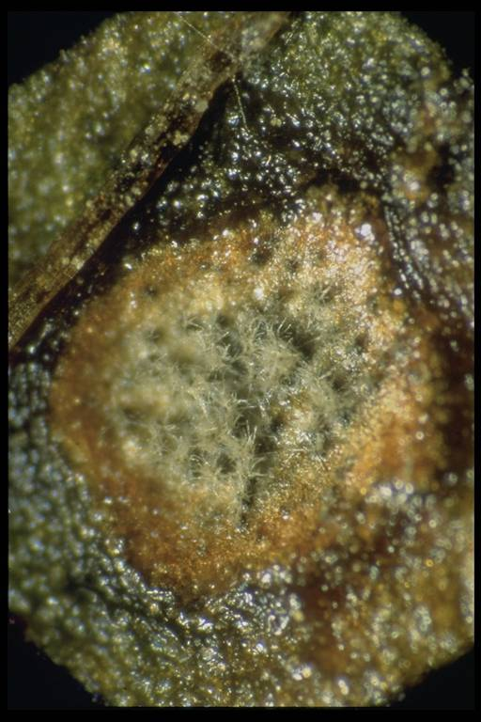
Cercospora Leaf Spot
Cercospora leaf spot (Cercospora beticola) is a fungal disease that occur in many sugar beet producing areas of the United States.
Infection often results in significant reductions in yield and sucrose such as in Southern Minnesota in 1981 where yield and sugars were reduced up to 50%.
The principal means of controlling losses due to infection is through tolerant varieties and/or fungicides.
In the last 50 years the pathogen has shown the ability to overcome fungicides.

Slide 3
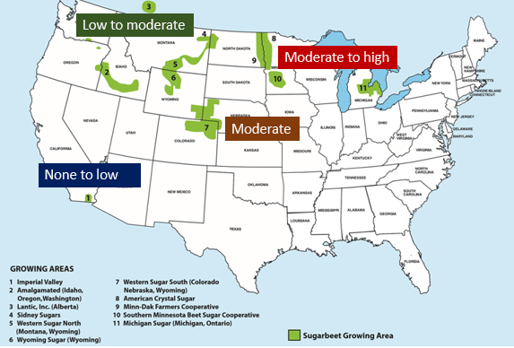
Cercospora Leaf Spot Incidence
Affects about 3/4ths of the North American sugar beet growing area
  MN, ND, MI are the major regions
Several severe infestations in North America have occurred in the last 40 years – early 1980’s, late 1990’s and most recently in 2016

Slide 4
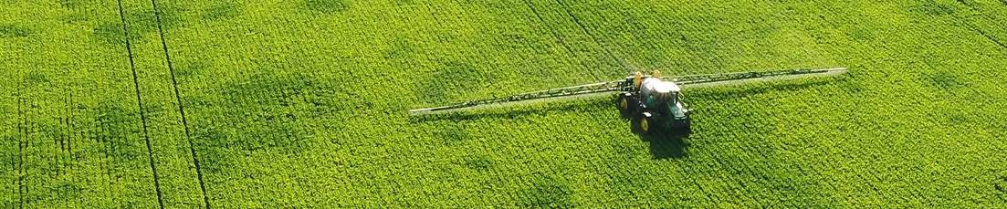
Management Of Cercospora Leaf Spot
Two main methods of controlling Cercospora
  Application of fungicides – monitoring systems are critical for timing the application
  Tolerant varieties
Other contributing factors
  Variety approval requirements
  Agronomic practices such as crop rotation, weed control, tillage methods, etc.

Slide 5
Variety Approval Requirement for Cercospora Changes Across N.A. Markets

Slide 6
Historic U.S. Beet Sugar Production (Lbs/A)
Roundup Ready® Sugarbeet
Gain per year ~2-3%
Source: USDA, National Agricultural Statistics Service, Crop Production; Farm Service Agency, Sweetener Market Data; World Agricultural Outlook Board, WASDE; Economic Research Service, Sugar and Sweetener Outlook.
https://ers.usda.gov./data-products/sugar-and-sweeteners-yearbood-tables/

Slide 7
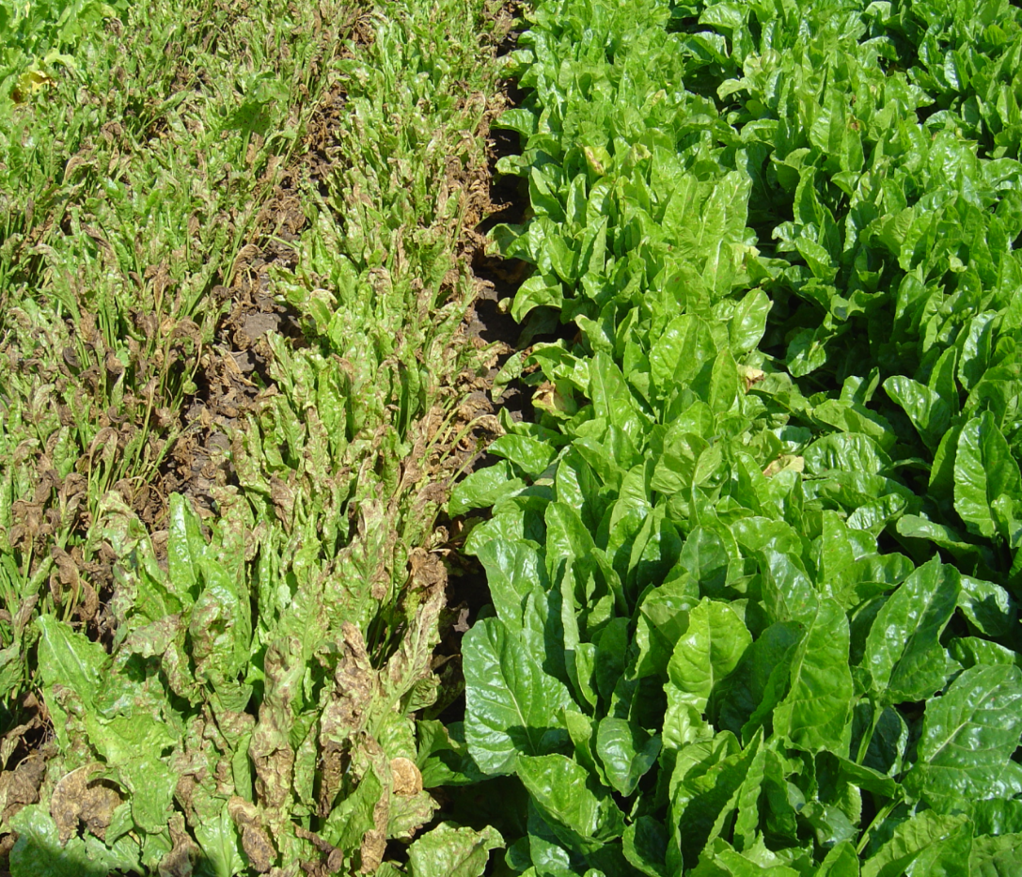
Breeding For Cercospora Tolerance
In the 80’s and 90’s the best Cercospora tolerant varieties were at least 10% lower in performance - tons and/or sugar content
Strong genetic variation for tolerance exists
Breeding challenge - inverse correlation between Cercospora tolerance and performance (sugar yield per unit of land)
Breeding strategy and methodology has changed over the last 25 years
Notes:
In the early 90’s the best resistant variety commercially available in the MI_OH growing area was Beta 5639, a triploid with exceptional Cercospora resistance . Even in the very high infestation area of Ohio this triploid variety had few spots while the rest of the hybrids showed moderate to high symptoms. But the only place this resistant variety sold was in this area of Ohio due to the lack of performance under lighter Cercospora infestations. By using the methodology of the USDA for field evaluations, especially key to their success was the possibility of artificial inoculation with irrigation, the selection for resistant material was successful
Several good sources of high resistance found in the USDA germplasm - FC506, SP69550, EL45

Slide 8
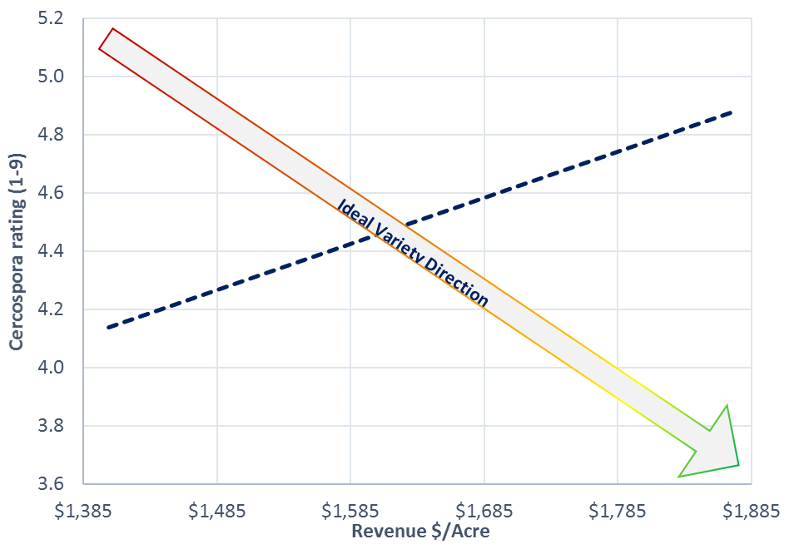
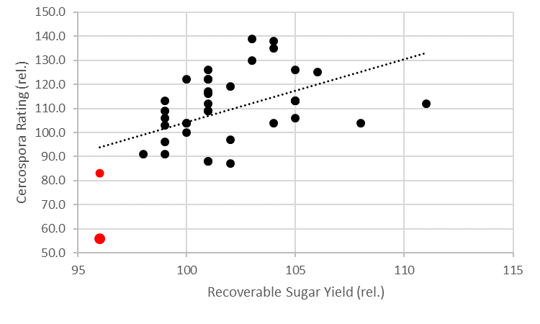
General Breeding Tendency Of Cercospora
Tolerance Versus Performance
Performance of varieties – 1992 & 1993 Michigan Sugar Company Official Variety Trial Results

Slide 9
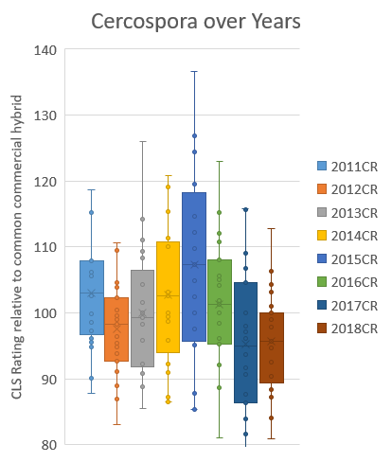
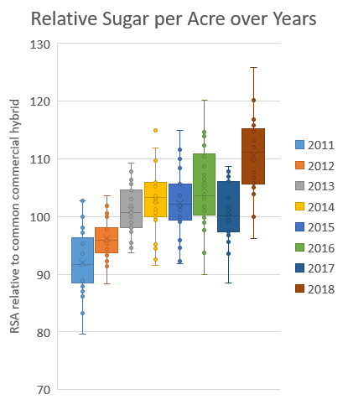
SMBSC Official Trial Data 2011-2018*
Betaseed Inc. Genetics
*Data used with permission from Southern Minnesota Beet Sugar Cooperative

Slide 10
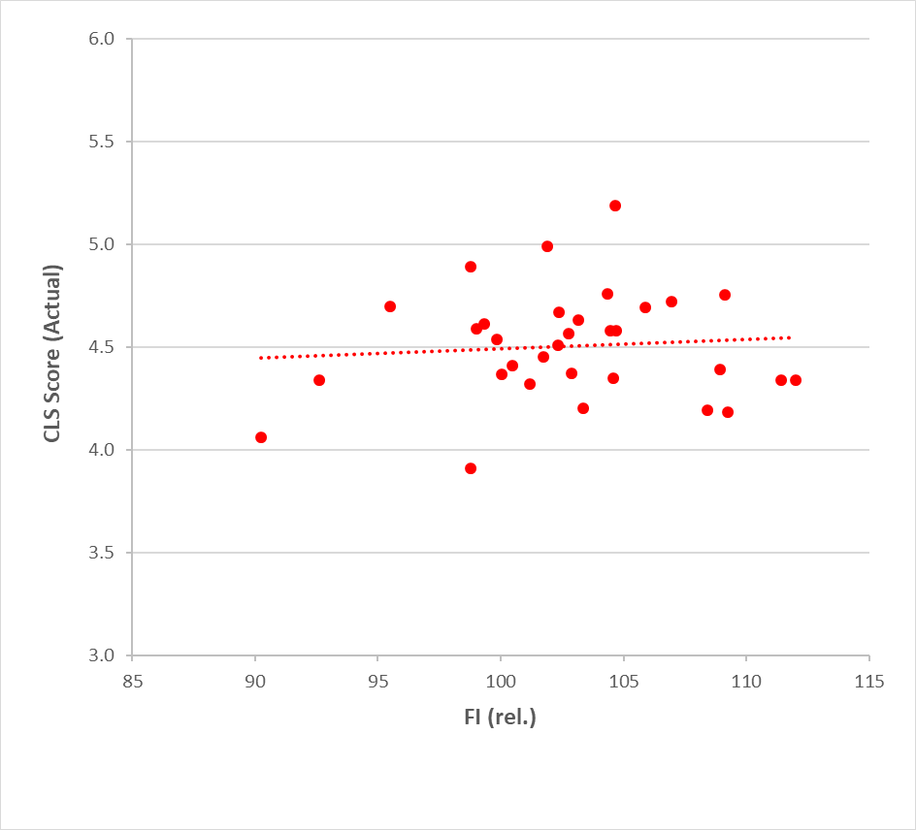
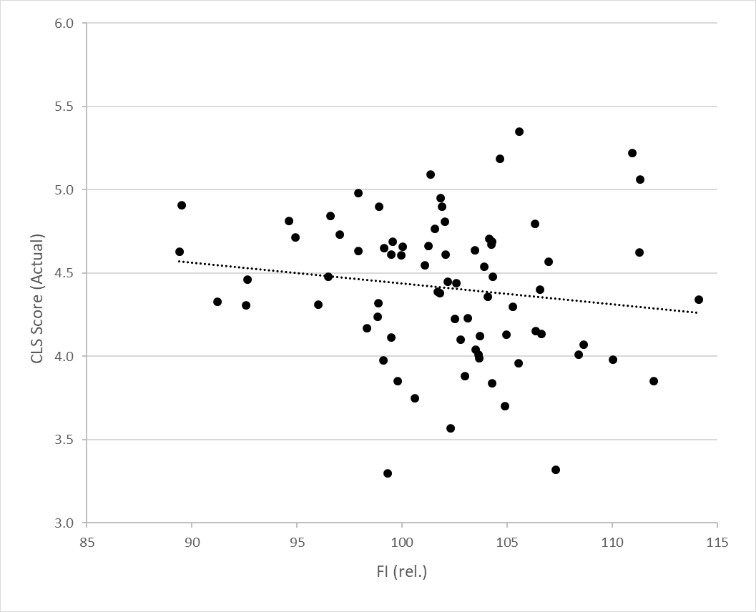
Last 6 Years Minn-Dak OVT Results*
Cercospora Score versus Financial Income
2013-14 Results
2015-18 Results
*Data used with permission from Minn-Dak Farmers Cooperative

Slide 11
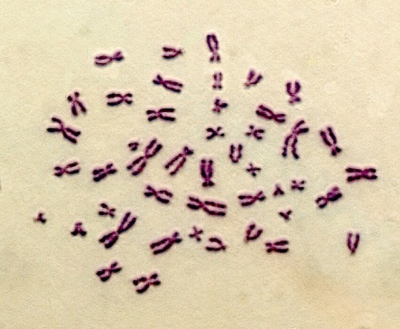

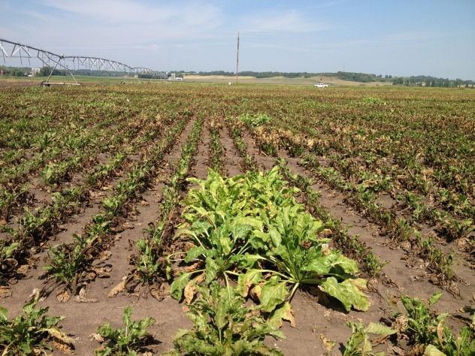
Milestones In The Development Of Cercospora Tolerant Hybrids
Genomic Selection
Introgression of H7-1
Marker Assisted Selection
Introgression of rhizomania resistance
Development of Cercospora tolerant diploid hybrids
Development of Cercospora tolerant triploid hybrids
Establishment of Cercospora Nursery
1970
1980
1990
2000
2010
2018

Slide 12
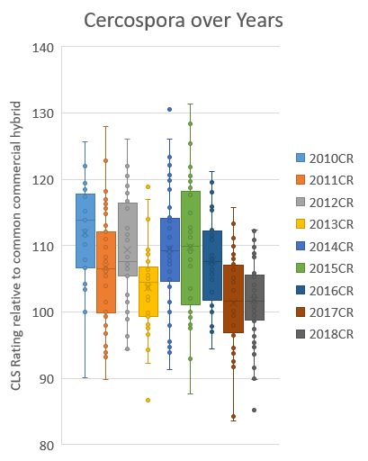
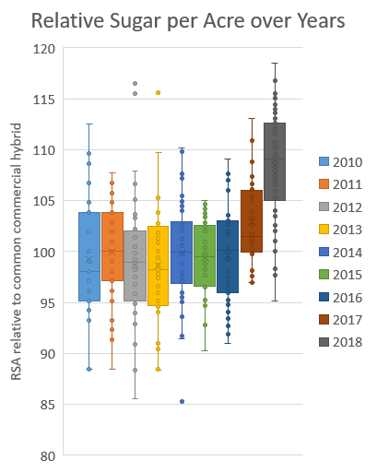
Advanced SCA Hybrids 2010-2018
Betaseed Inc. Genetics - Red River Valley

Slide 13
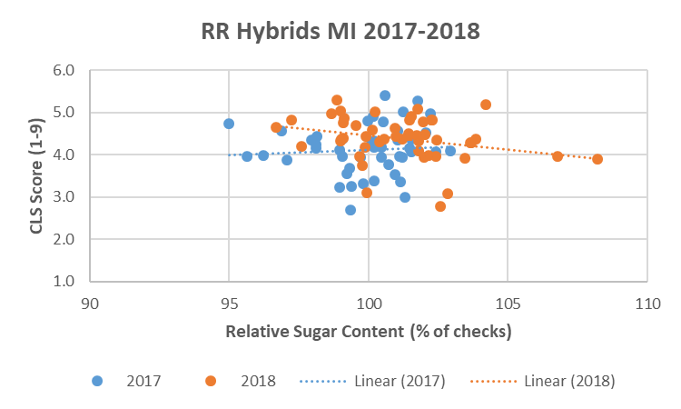
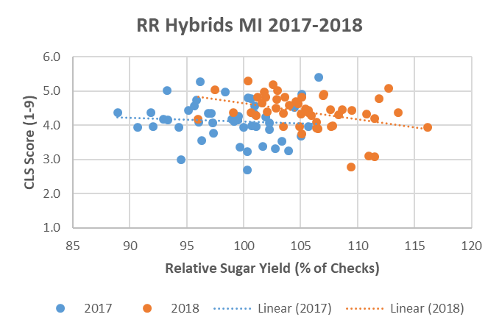
Performance Of Cercospora Tolerant Material
Michigan Proprietary Yield Trial (2017 and 2018)
Opportunity exists to select highly tolerant hybrids that are comparable in performance to less tolerant hybrids

Slide 14
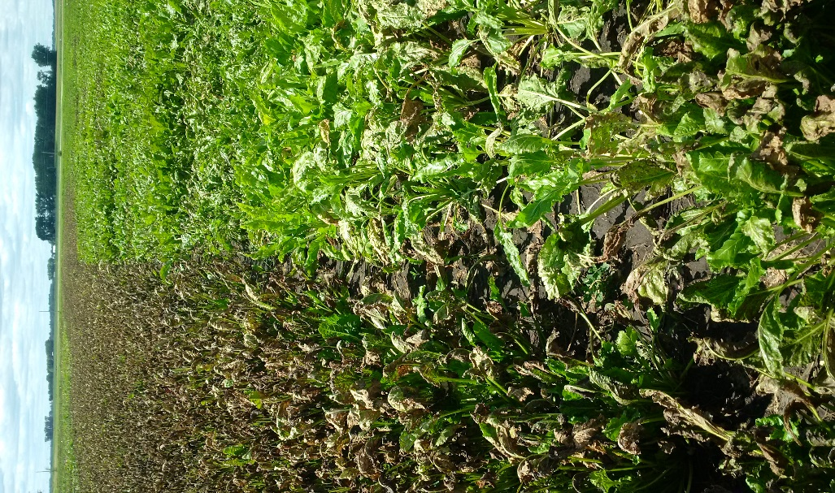
Development Of Cercospora
Tolerant Hybrids
Evaluation of thousands of new potential lines annually in our Cercospora nurseries.
Development of molecular tools to facilitate quicker breeding gain – GS, QTL identification.
Addition of important traits into highly Cercospora tolerant hybrids: nematode, rhizomania, root rots, root aphid, herbicide tolerance.

Slide 15
Summary
Breeding advances have provided better Cercospora tolerant varieties
The inverse correlation of Cercospora tolerant to sugar yield still exists but to a lesser extent than 25 years ago
Some highly Cercospora tolerant varieties show comparable performance and higher revenue to non-tolerant hybrids even under no infection
Important Cercospora tolerant materials are widely used in North America
Over the last 10 years the gain in sugar yield is about 2% to 3% per year including Cercospora tolerant hybrids
Notes:
What is the benefit of American breeding for Europe

Slide 16
Future
Changes in variety approval policies
Less use of fungicides
New sources of resistance/tolerance
Development of new breeding methods and tools
Higher resistance/tolerance without loss of performance

Slide 17
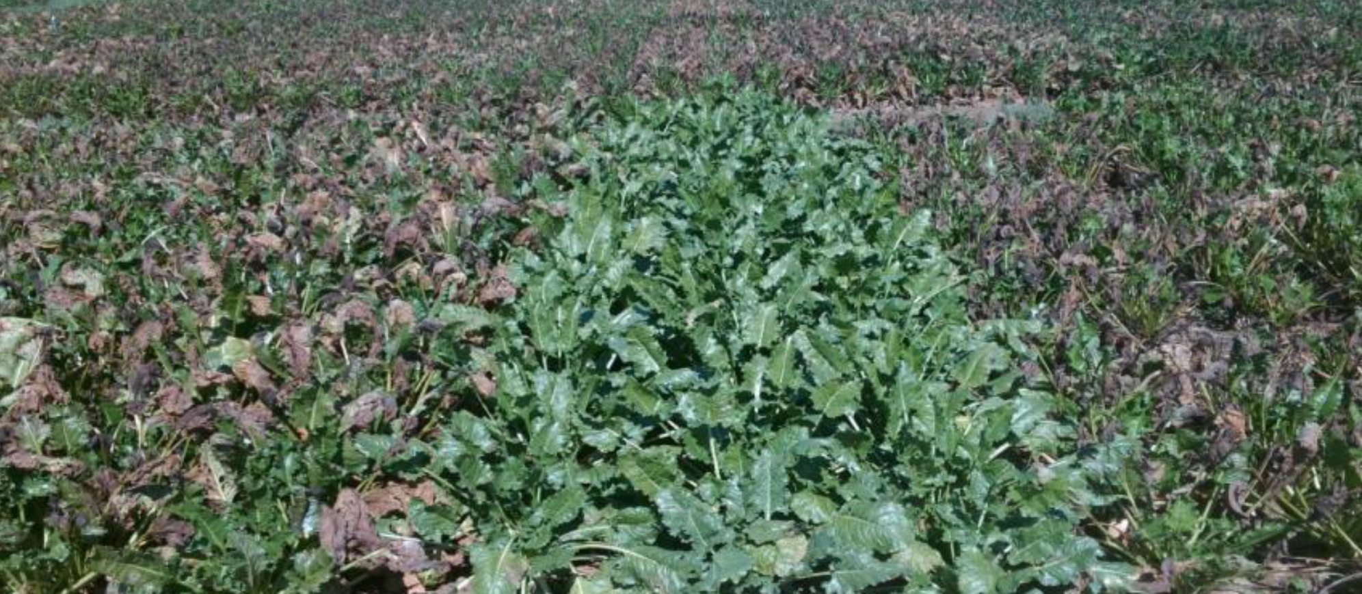
Acknowledgement And References
Acknowledgements
  Data used with permission from Research Groups of Michigan Sugar Company, Minn-Dak Farmers Cooperative and SMBSC
References
  Compendium of Beet Diseases and Pests Second Edition (2009). The American Phytopathological Society.
  Miller, J., Rekoske, M., and Quinn, A. (1994). Genetic resistance, fungicide protection and variety approval policies for controlling yield losses from Cercospora leaf spot infections. J. Sugar Beet Res. 31, 7–12.
  Smith, G. A., and Gaskill, J. O. (1970). Inheritance of resistance to Cercospora leafspot in sugarbeet. J. Am. Soc. Sugar Beet Technol. 16, 172–180.
  Vogel J, Kenter C, Holst C and Märländer B (2018) New Generation of Resistant Sugar Beet Varieties for Advanced Integrated Management of Cercospora Leaf Spot in Central Europe. Front. Plant Sci. 9:222.

