Slide 1
Dennis Bischer, Agronomist
Michigan Sugar Co.

Slide 2
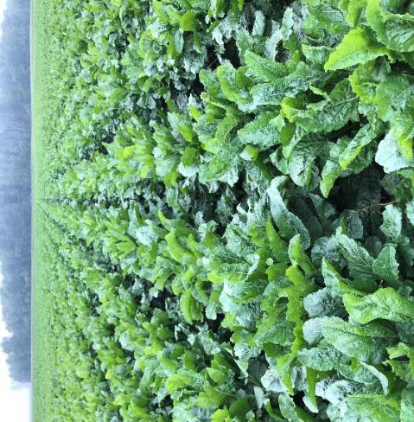
Alternaria Leafspot
History of alternaria in Michigan
Fungicide efficacy and treatments
Conclusions and observations
Strategies in Michigan

Slide 3
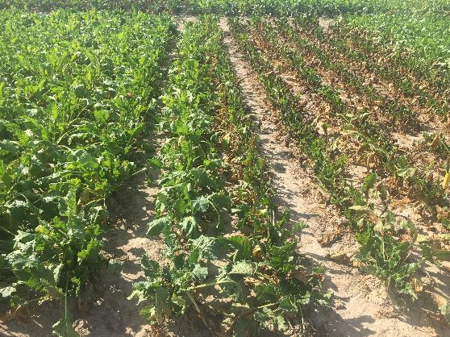
Alternaria Leafspot in Michigan
Low levels of disease for a long period of time
Recent years have had significant amounts of infection
Factors for increased disease levels
Susceptible variety planted on a significant percentage of acres
Decreased fungicide activity
Increased inoculum levels

Slide 4
Cercospora and Alternaria Leafspot
Both diseases are present in Michigan
The severity of each disease is equal
Created challenges
Fungicides vary in their efficacy to both diseases
Some fungicides are good on cercospora but poor on alternaria
Length of time for disease control has increased
Start earlier and spray later

Slide 5
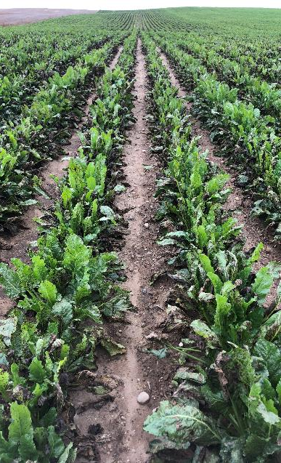
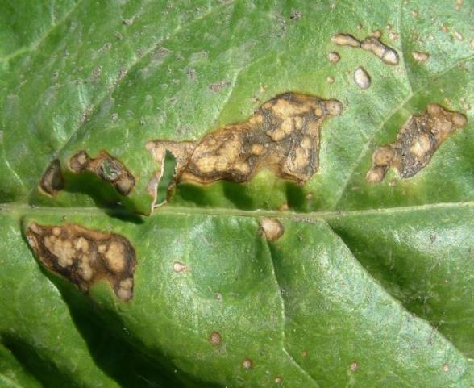
Alternaria Leafspot
Infects between 50-90 degrees F
More severe in unhealthy plants
Varieties vary in their tolerance
Fungicides vary in their efficacy
Economic impact is similar to Cercospora leafspot

Slide 6
Control of Alternaria Leafspot with Fungicides
Trials have occurred over multiple years and multiple locations
Evaluated the efficacy of fungicides for control of Alternaria leafspot
The following trial is a good representation of multiple test sites

Slide 7
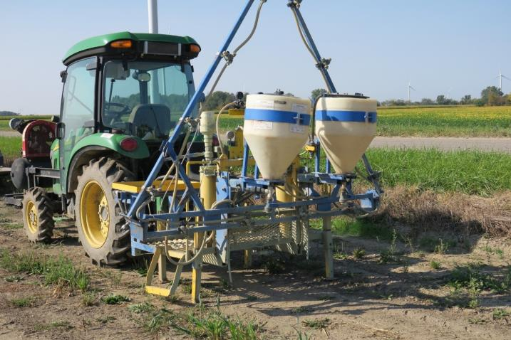
Control of Alternaria Leafspot with Fungicides
Plot size: 6 rows (22 inch) x 38 ft
3 replications
Monosem research planter 4.1 to 4.5 inch seed spacing
Final population of 200 beets/100 ft
Compressed air small plot sprayer
3 mph
25 gallons per acre
100 psi

Slide 8
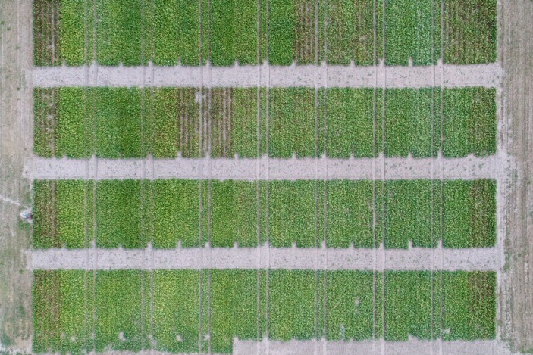
Control of Alternaria Leafspot with Fungicides
Variety used-C-RR059
Susceptible to alternaria
Moderately tolerant to cercospora
Multiple fungicides were tested for their efficacy
The trial was NOT inoculated
Disease pressure was severe

Slide 9
Control of Alternaria Leafspot with Fungicides
Treatment | Tank Mix | No of Apps | Rotational Fungicide
Echo(chlorothalonil) | None | 8 | None
Super Tin | Topsin + Manzate | 7 | Badge(4 apps)
Manzate | Badge(copper) | 8 | None
Super Tin | Manzate | 7 | Badge(4 apps)
Badge(copper) | None | 8 | None
Manzate | None | 8 | None
Minerva Duo | None | 7 | Badge(3 apps)
Priaxor | Manzate | 7 | Badge(4 apps)
Headline | Manzate | 7 | Badge(4 apps)
Inspire XT | Manzate | 7 | Badge(3 apps)
Minerva | Manzate | 7 | Badge(3 apps)

Slide 10
Control of Alternaria Leafspot with Fungicides
Treatments were rated for % leaf damage
Treatments were harvested and tested for:
RWSA-sugar per acre
RWST-sugar per ton
Tons/acre

Slide 11
% Leaf Damage

Slide 12
% Leaf Damage and RWSA

Slide 13
% Leaf Damage and Tons/Acre

Slide 14
% Leaf Damage and RWST

Slide 15
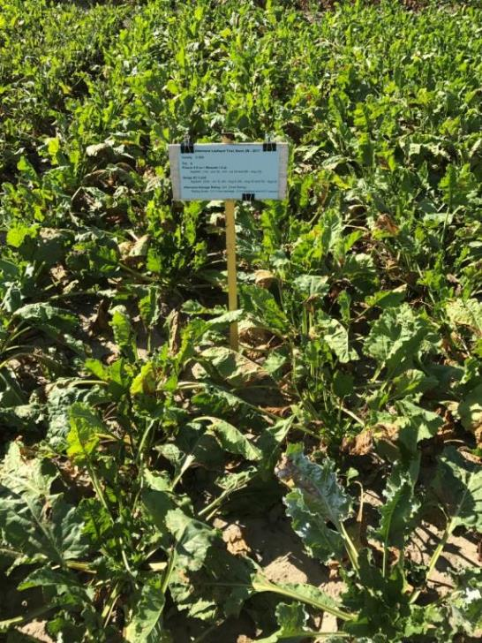
Comparison of Treatments
Super Tin + Topsin + Manzate
8.0% Leaf Damage
Priaxor + Manzate
30.7% Leaf Damage

Slide 16
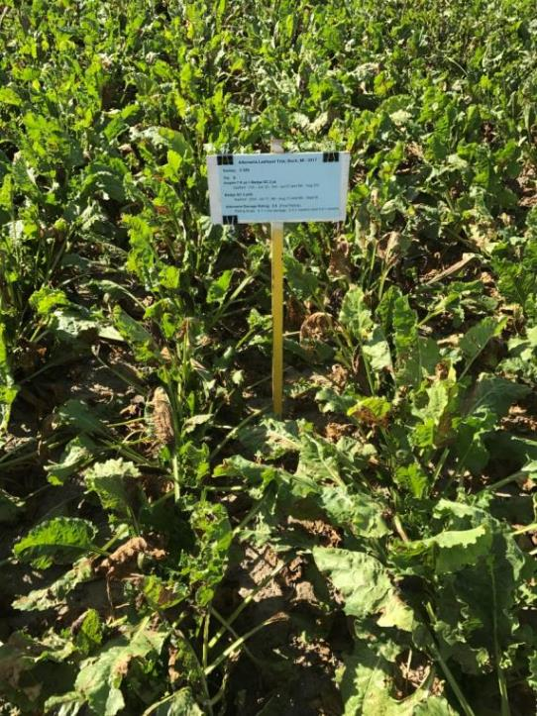
Comparison of Treatments
Super Tin + Topsin + Manzate
8.0% Leaf Damage
Inspire XT + Manzate
39.3% Leaf Damage

Slide 17
Comparison of Treatments
Priaxor + Manzate
30.7% Leaf Damage
Inspire XT + Manzate
39.3% Leaf Damage

Slide 18
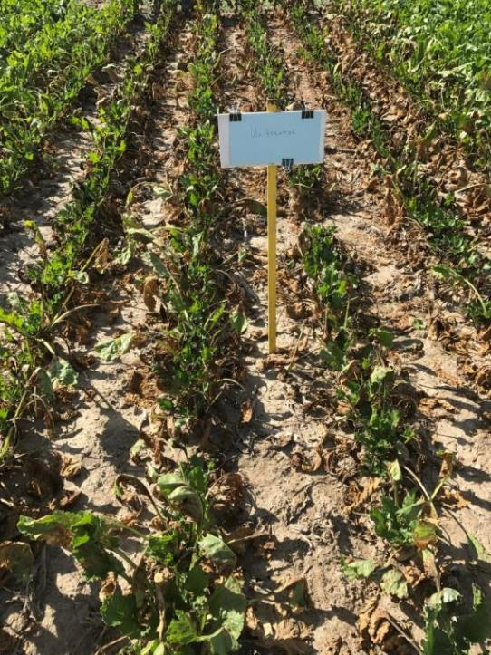
Comparison of Treatments
Super Tin + Topsin + Manzate
8.0% Leaf Damage
Untreated
100% Leaf Damage

Slide 19
Conclusions and Observations
Fungicides vary in their efficacy for alternaria control
Alternaria
1. Super Tin
2. EBDC
3. Strobilurin
4. Copper
5. Triazole

Slide 20
Conclusions and Observations
Fungicides vary in their efficacy for alternaria control
Fungicide efficacy is different for alternaria and cercospora
Alternaria | Cercospora
1. Super Tin | 1. Super Tin
2. EBDC | 2. Triazole
3. Strobilurin | 3. EBDC
4. Copper | 4. Strobilurin
5. Triazole | 5. Copper

Slide 21
Conclusions and Observations
Fungicides vary in their efficacy for alternaria control
Fungicide efficacy is different for alternaria and cercospora
Tank mixing fungicides reduces leaf damage

Slide 22
Conclusions and Observations
The economic impact of alternaria leafspot is significant

Slide 23
Alternaria and Cercospora Control Strategies in Michigan
Genetic tolerance
Timing of first fungicide
Late June
Application intervals of 10-14 days
Rotate chemistry
Tank-mix
Fungicide applications have two or more effective products in the tank

Slide 24
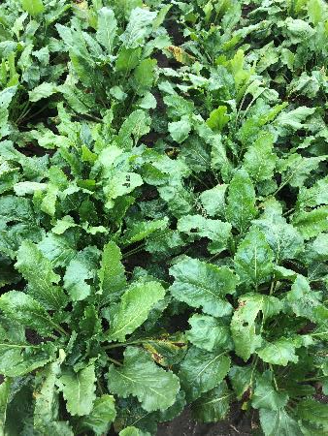
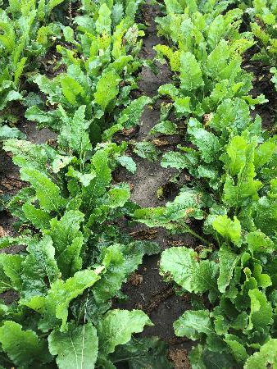
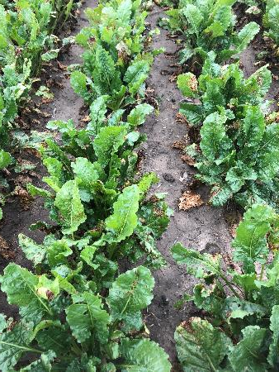
Alternaria and Cercospora Control Strategies in Michigan
Genetic tolerance
Wide range of tolerance between varieties
H-9879NT
Alternaria-Good
Cercospora-Good
C-333NT
Alternaria-Fair Plus
Cercospora-Poor
C-515
Alternaria-Poor
Cercospora-Fair Minus
All varieties were sprayed 6 times with the same products and application dates

Slide 25
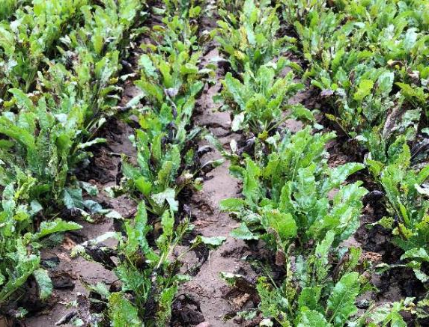
Timing of First Application
Date | Product | % Leaf Damage
 |  | 18.1
7-3 | Priaxor+Manz
7-17 | Tin+Manz
7-31 | Priaxor+Manz
8-14 | Inspire+Manz
8-30 | Badge
Date | Product | % Leaf Damage
6-28 | Manzate | 6.3
7-3 | Priaxor+Manz
7-17 | Tin+Manz
7-31 | Priaxor+Manz
8-14 | Inspire+Manz
8-30 | Badge

Slide 26
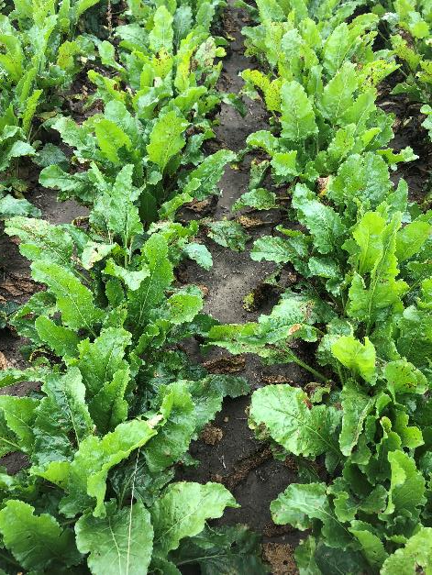
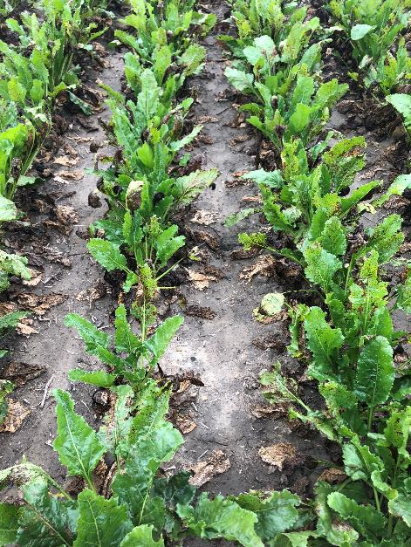
Alternaria and Cercospora Control Strategies in Michigan
Application Interval
C-333NT
Alternaria-Fair Plus
Cercospora-Poor
6 fungicide applications
3.9% Leafspot Damage
C-333NT
Alternaria-Fair Plus
Cercospora-Poor
5 fungicide applications
41.7% Leafspot Damage

Slide 27
Alternaria and Cercospora Control Strategies in Michigan
Tank-mix
Fungicide applications have two or more effective products in the tank

Slide 28
Alternaria and Cercospora Control Strategies in Michigan
Genetic tolerance
Timing of first fungicide
Late June
Application intervals of 10-14 days
Rotate chemistry
Tank-mix
Fungicide applications have two or more effective products in the tank

Slide 29
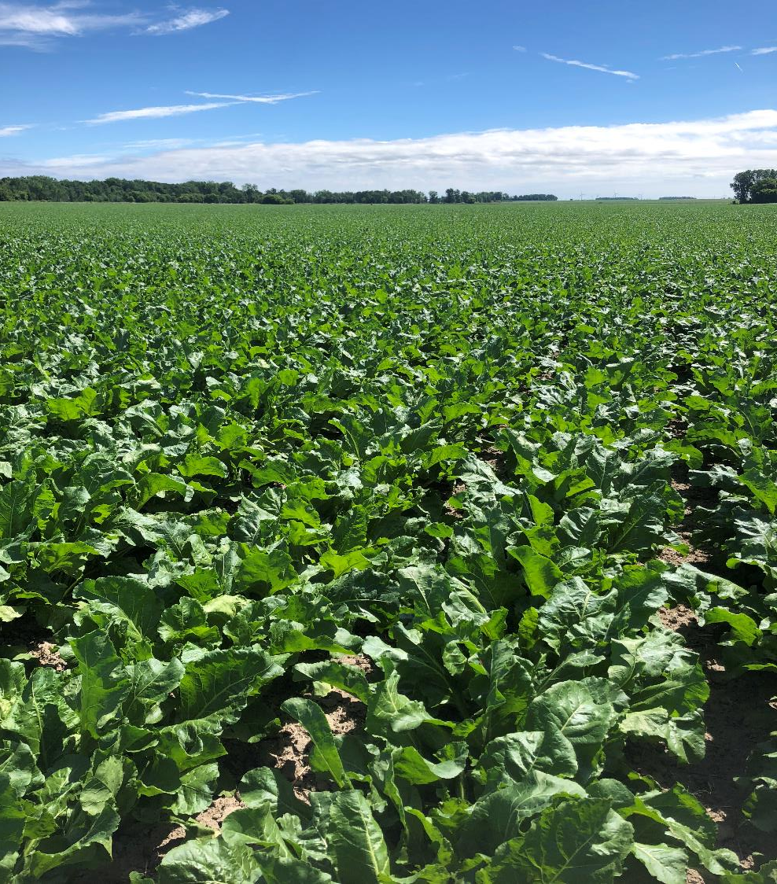
Thank You!

